Slide 1
Rally Usage
October 2017

Slide 2
Agenda
Rally URL and accessibility
Backlog
Iteration Status, Team Status, Story Board
Team Status Navigation
Story Board – is always current
Creating a new user story – Backlog, Iteration, User Stories
Feature – Create a new user story
Creating Views in Rally
Dashboard
Reports

Slide 3
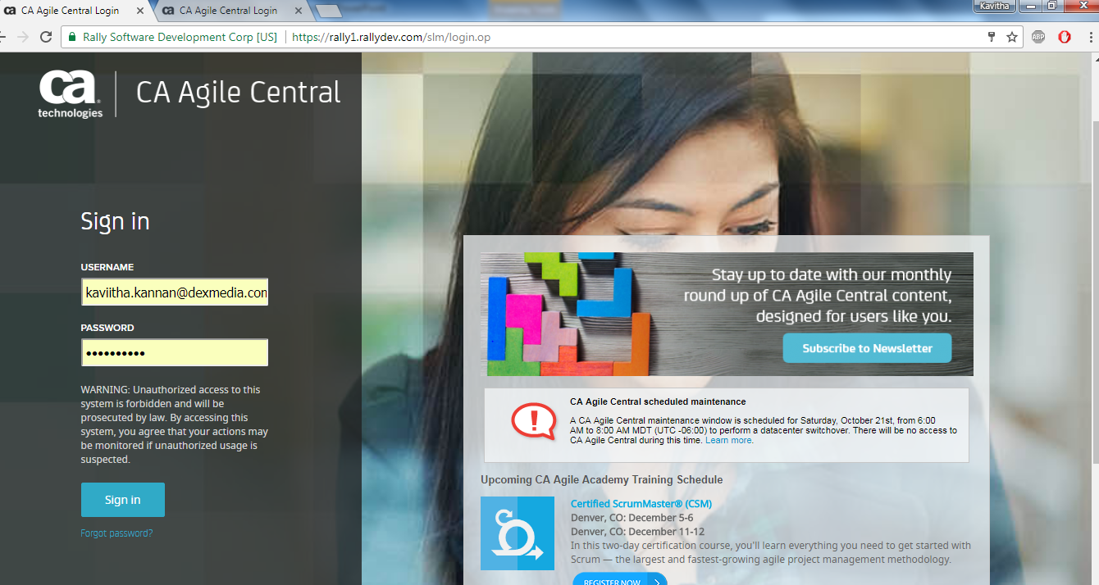
Rally URL and accessibility
Rally URL : https://rally1.rallydev.com
Rally is now CA Agile Central.

Slide 4
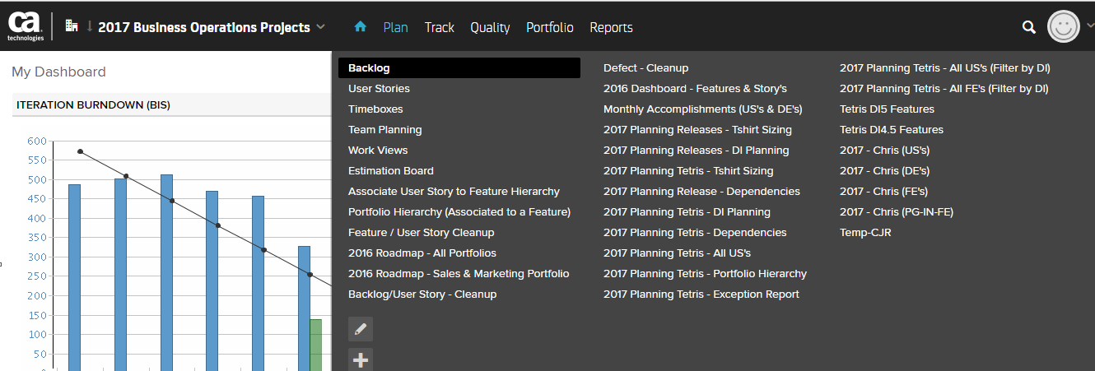
Backlog

Slide 5
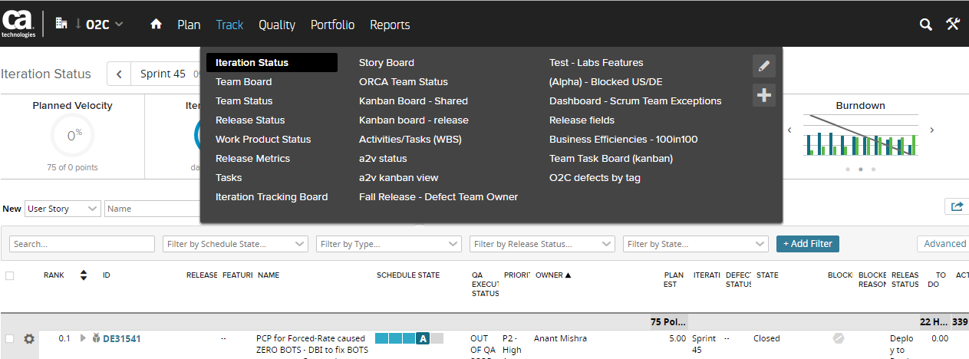
Iteration Status, Team Status, Story Board

Slide 6
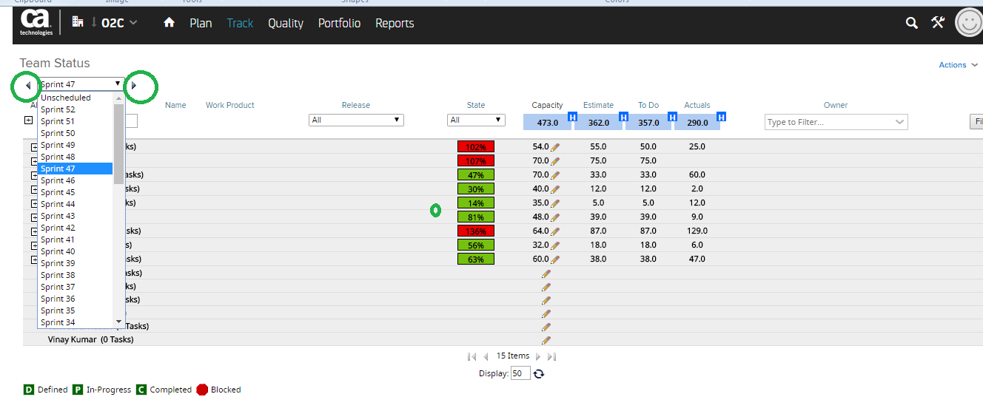
Team Status Navigation

Slide 7
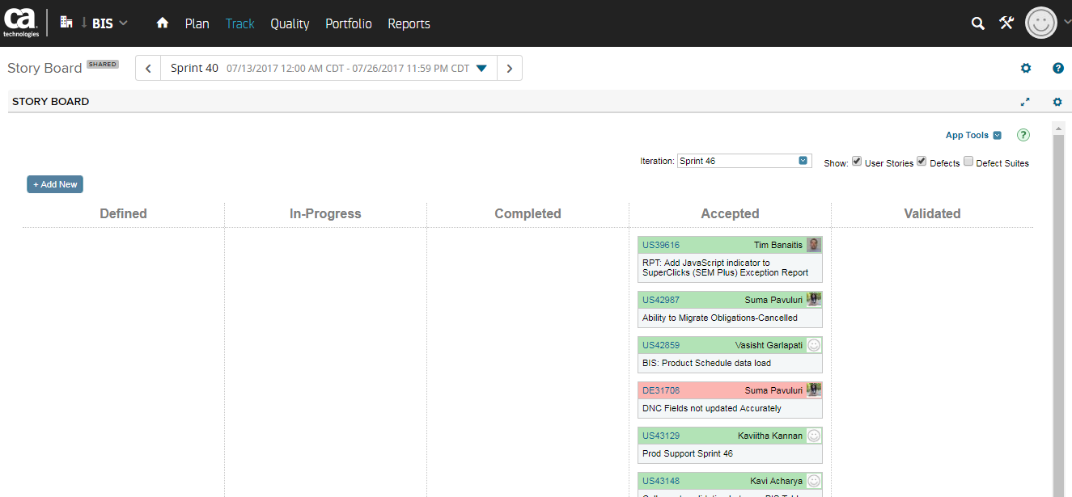
Story Board is always the current sprint

Slide 8
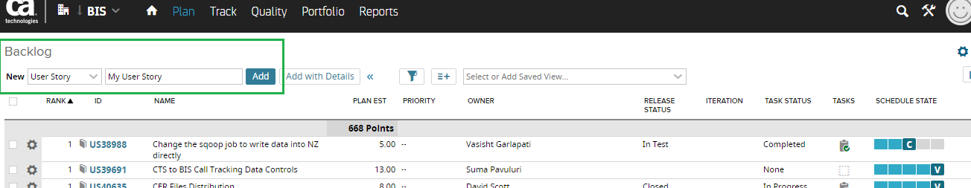
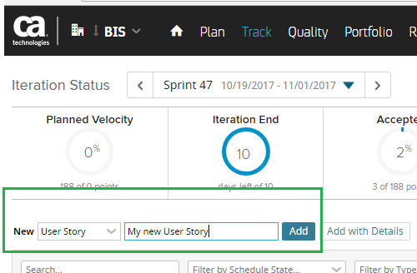
Creating a new user story – Backlog, Iteration, User Stories

Slide 9
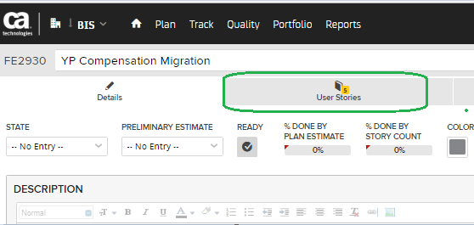
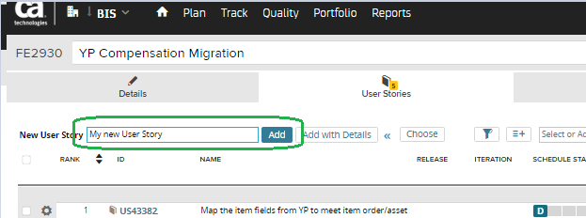
Feature – Create a new user story

Slide 10
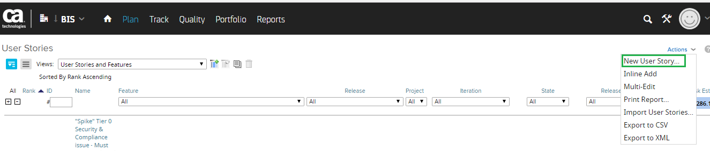
Plan – User Story, Actions, New User Story

Slide 11
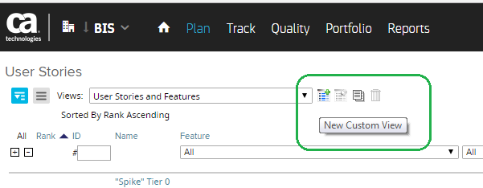
Creating Views in Rally

Slide 12
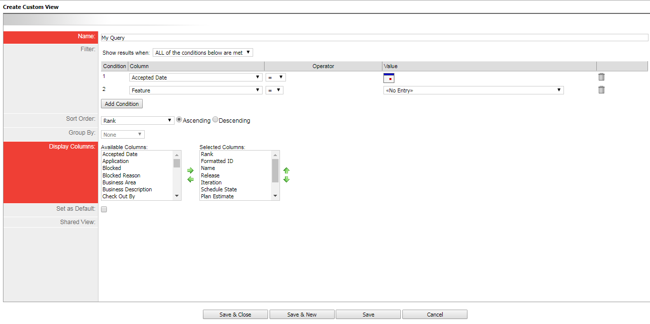
Create Custom View

Slide 13
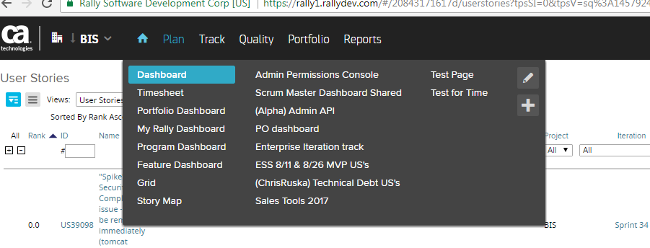
Dashboard

Slide 14
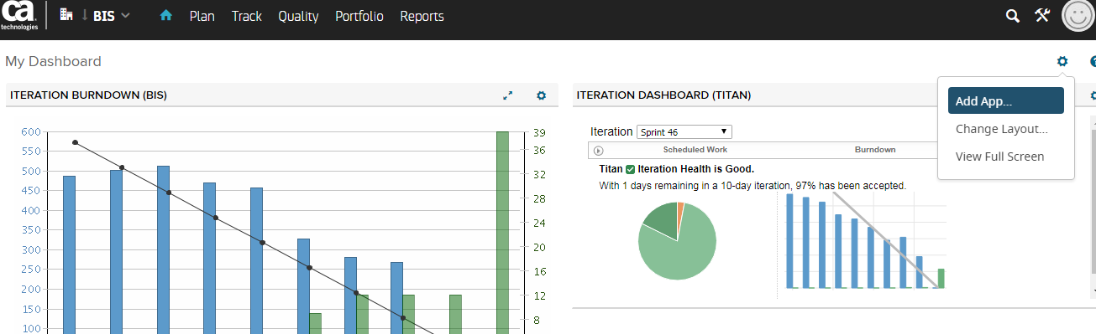
Adding an App to your Dashboard

Slide 15
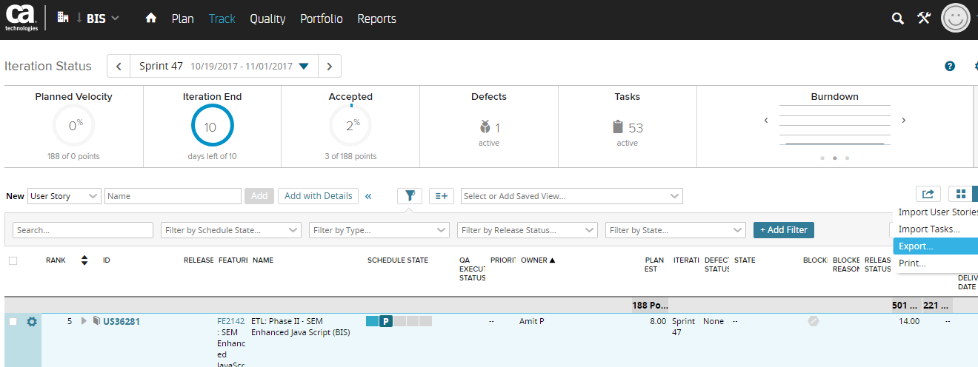
Reports

